Slide 1
Java full stack development Module 1 : internet basics

Slide 2
Why This matters
Before coding → understand how things work
Websites are not magic
Everything follows a flow

Slide 3
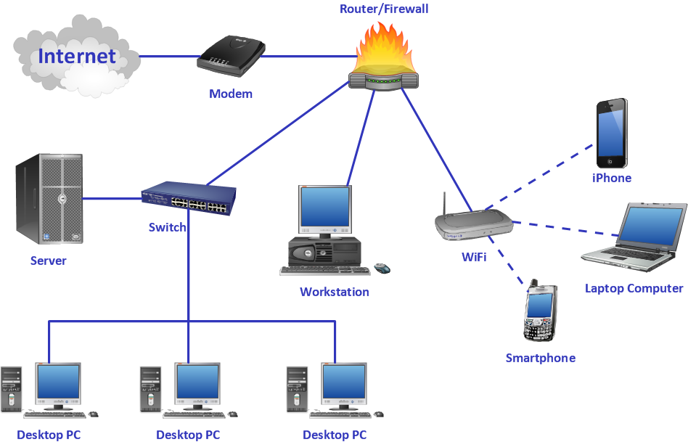

WHAT IS INTERNET Internet = Network Of Computers Millions Of Devices Connected Data Travels Between Them

Slide 4
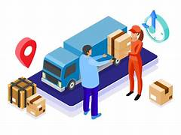
REAL LIFE EXAMPLE
Internet = Delivery System
You request
Data travels
You receive

Slide 5

WHAT IS A WEBSITE
Website = Collection of files
HTML
CSS
JavaScript

Slide 6
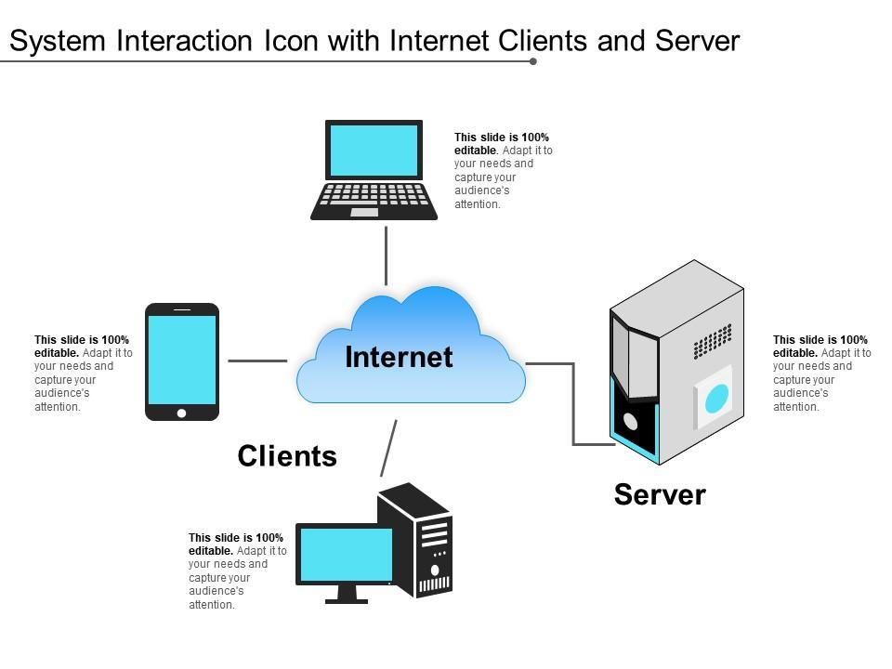
WHAT IS SERVER
Server = Computer storing websites
Stores data
Sends data when requested

Slide 7
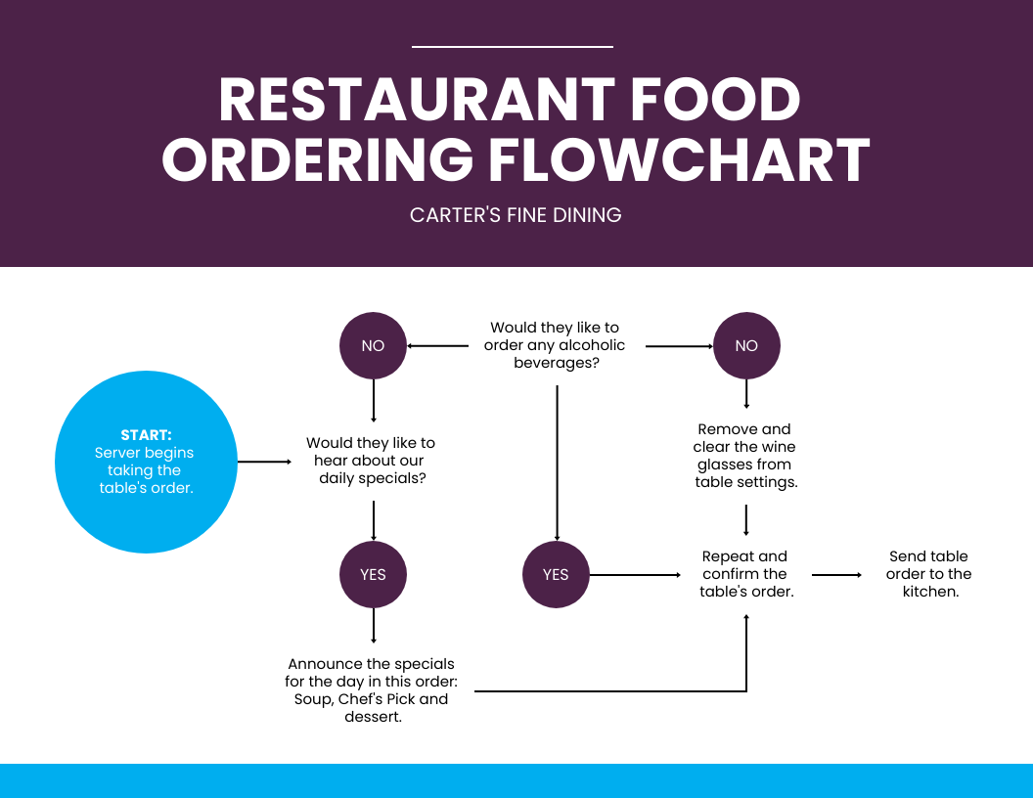
RESTAURANT EXAMPLE
👤User → Customer
🧑‍💼Browser → Waiter
🧑‍🍳 Server → Kitchen

Slide 8
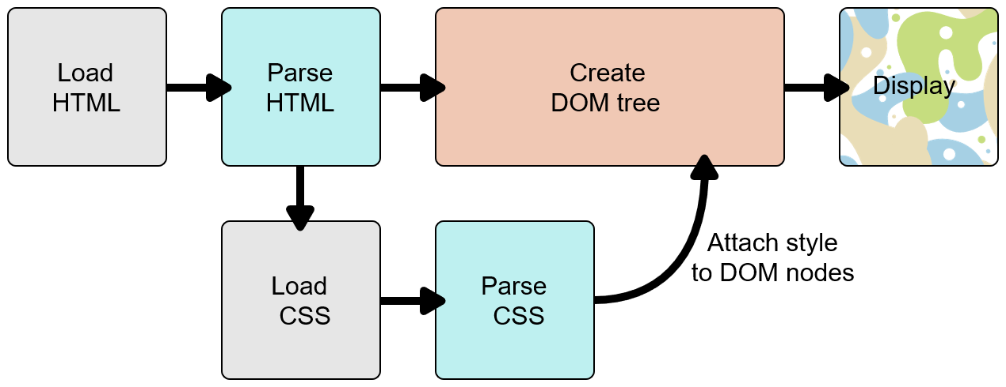
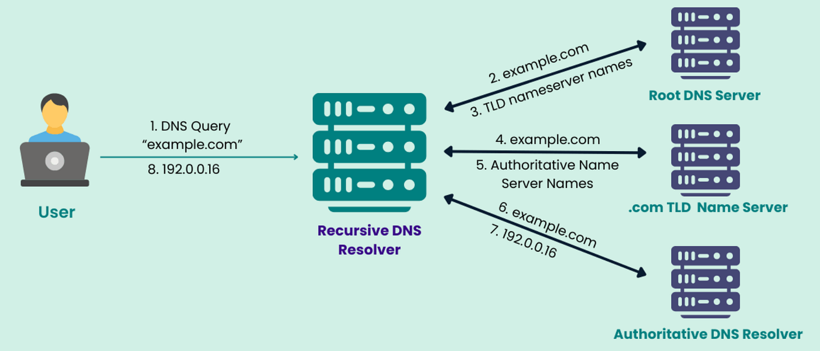
COMPLETE INTERNET FLOW
User → Browser → DNS → Server → Response

Slide 9
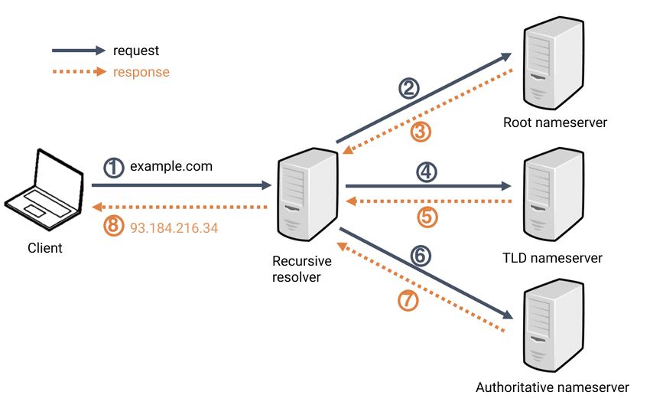
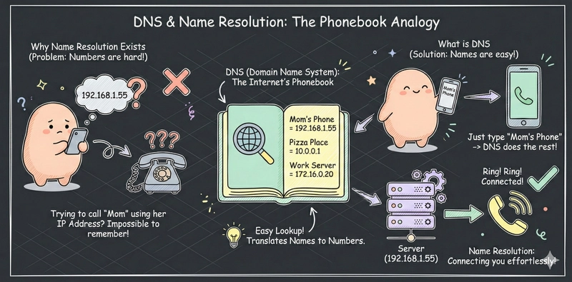
WHAT IS DNS
DNS = Internet Phonebook
Converts name → IP address

Slide 10
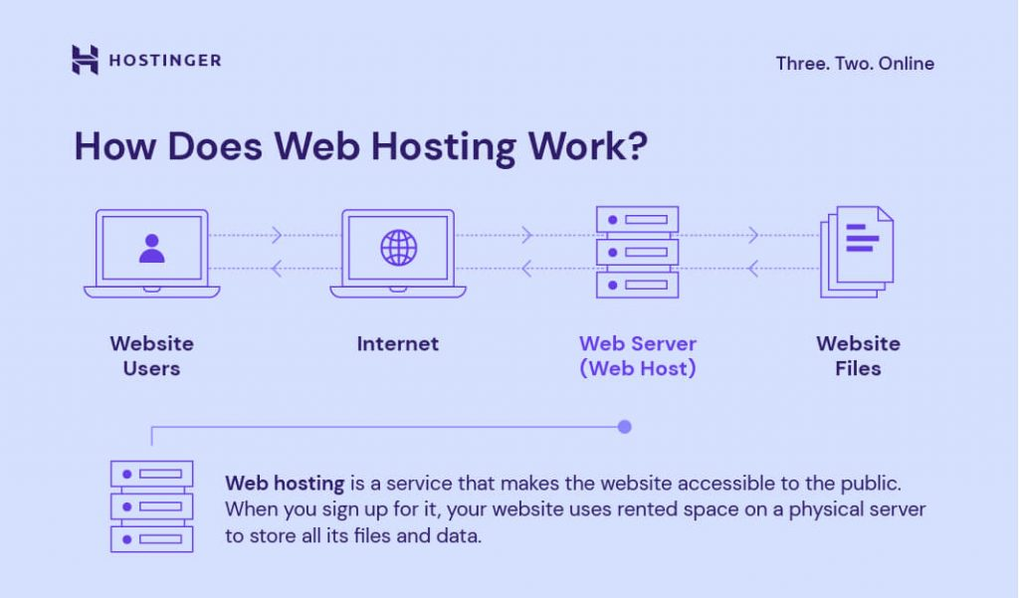
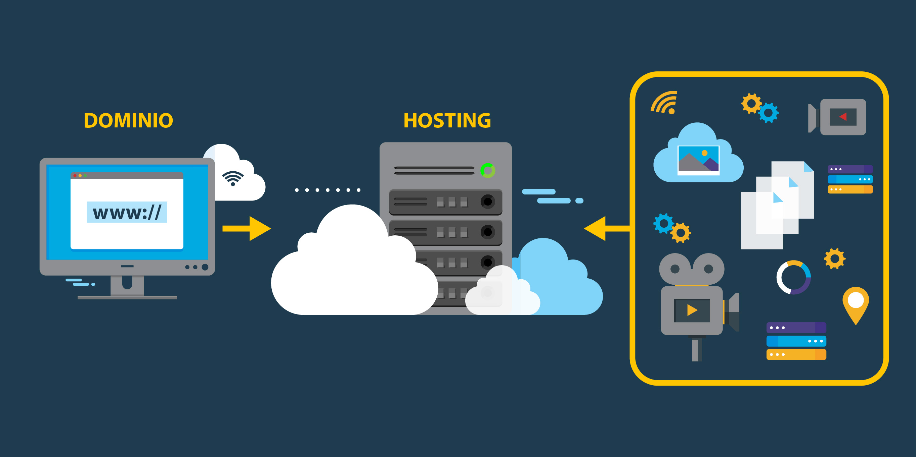
WHAT IS HOSTING
Hosting = Storing website on server
Available 24/7
Accessible from anywhere

Slide 11
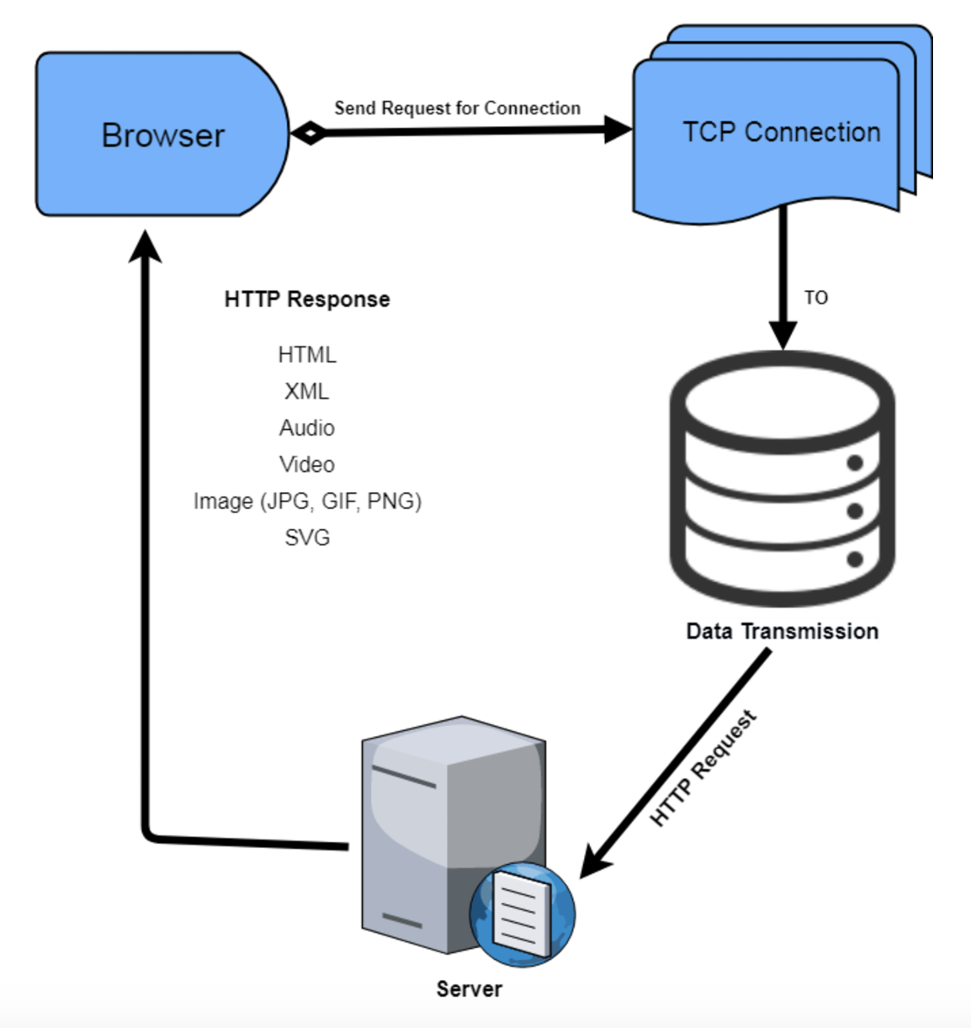
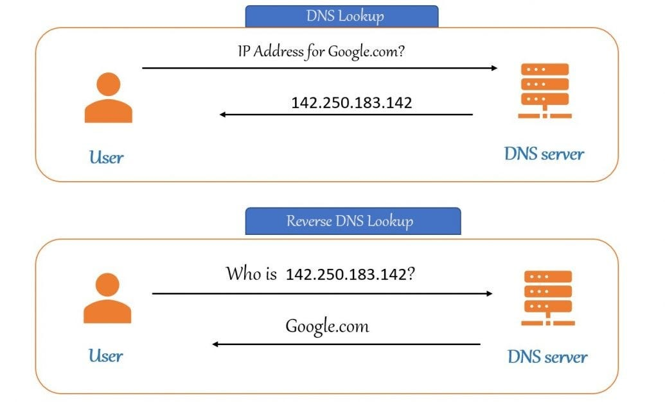
WHAT HAPPENS WHEN YOU TYPE GOOGLE.COM
Enter URL
DNS finds IP
Request goes
Server responds
Page loads

Slide 12
REAL DEMO
Open browser → Inspect → Network

Slide 13
END
Today you understood how websites work Soon you will build them.

